Slide 1
HIT391 – MACHINE LEARNING: ADVANCEMENTS AND APPLICATIONS
ASSIGNMENT 3 - GROUP ASSIGNMENT

Slide 2

OUTLINE
INTRODUCTION
DATASETS
CLUSTERING ALGORITHMS
  K-Means
  Hierarchical
CLASSIFICATION ALGORITHMS
  Logistic Regression
  Random Forest
CONCLUSION

Slide 3
I. INTRODUCTION
This project aimed to apply machine learning techniques to two distinct tasks involving real-world datasets. The first task focused on clustering individuals based on their hobbies and interests using unsupervised learning methods. The second task required the implementation of classification algorithms to predict survival outcomes in the Titanic shipwreck scenario, a classic supervised learning problem. These tasks provided hands-on experience with end-to-end data science workflows, including data preprocessing, model development, hyperparameter tuning, and evaluation. The primary goal was to demonstrate the ability to select appropriate models, apply them correctly, and interpret the results meaningfully.

Slide 4
II. DATASETS DESCRIPTION
Task 1: kaggle_Interests_group.csv (Clustering)
6340 individuals with binary indicators across 217 interest categories (e.g., sports, music, travel).
Unlabeled data, suitable for unsupervised clustering.
Goal: Identify natural groupings based on shared interests using K-Means and Hierarchical Clustering.
Task 2: Titanic – Machine Learning from Disaster (Classification)
train.csv: 891 passengers with survival labels (0 = did not survive, 1 = survived).
test.csv: 418 passengers, used for predictions.
gender_submission.csv: Sample baseline predicting all females survived.
Focus on demographic & ticketing features (Age, Sex, Pclass, Fare, Embarked).

Slide 5
III. CLUSTERING ALGORITHMS
Data Processing
Preparing the dataset for clustering analysis:
Training Details:
Dataset used: kaggle_Interests_group.csv (categorical features about user interests).
Loaded using pandas and inspected with .shape, .head(), .info() to understand the structure.
Handled missing values:
+Dropped columns with more than 1000 missing values.
+Filled remaining missing values with the median (excluding the "group" column).
Encoded the "group" column using LabelEncoder.
Computed and visualized a correlation matrix (heatmap) to identify feature relationships.
Selected 3 key features for analysis: group, grand_tot_interests, interest47.
Applied MinMaxScaler to normalize grand_tot_interests, then standardized all features with StandardScaler.

Slide 6

III. CLUSTERING ALGORITHMS
Data Splitting
Splitting the dataset for training, evaluation, and testing:
Although clustering is unsupervised, splitting helps simulate real-world development and avoid overfitting.
Dataset split into:
  60% Train (X_train) – to train clustering models.
  20% Eval (X_eval) – to evaluate clustering performance (e.g., silhouette score).
  20% Test (X_test) – reserved for final testing or visualizations.
This separation allows for model tuning and unbiased evaluation.

Slide 7
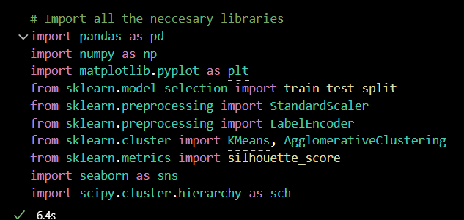
III. CLUSTERING ALGORITHMS
Model Implementation
Setting up clustering algorithms and tools:
Two clustering models was selected.
  KMeans Clustering
  Hierarchial Clustering
Imported all essential libraries:
  pandas, numpy – for data handling
  matplotlib, seaborn – for data visualization
  sklearn modules – for encoding, scaling, and clustering
  scipy – for creating dendrograms
Models were initialized and prepared in this step; actual training and evaluation are done in the next phase.

Slide 8
CLUSTERING ALGORITHMS
Model Training – K-Means Clustering
Once the data was preprocessed, normalised, and split, we trained the KMeans clustering model using the scaled training dataset derived from the kaggle_Interests_group.csv file
Training Details:
Dataset: kaggle_Interests_group.csv (60% for training)
Algorithm: KMeans (sklearn.cluster)
Optimal k = 5, selected using the Elbow Method (WCSS curve & KneeLocator)
Training Steps:
Data normalized & split
Model trained with KMeans(n_clusters=5, random_state=42)
Cluster labels predicted & assigned

Slide 9
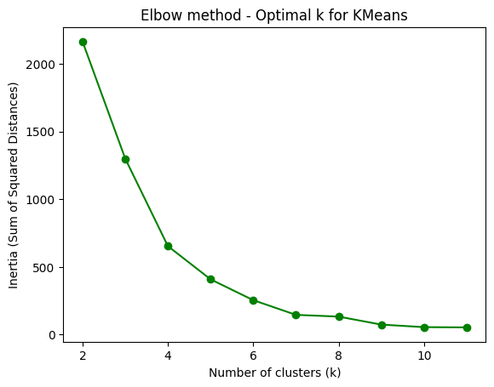
CLUSTERING ALGORITHMS

Slide 10
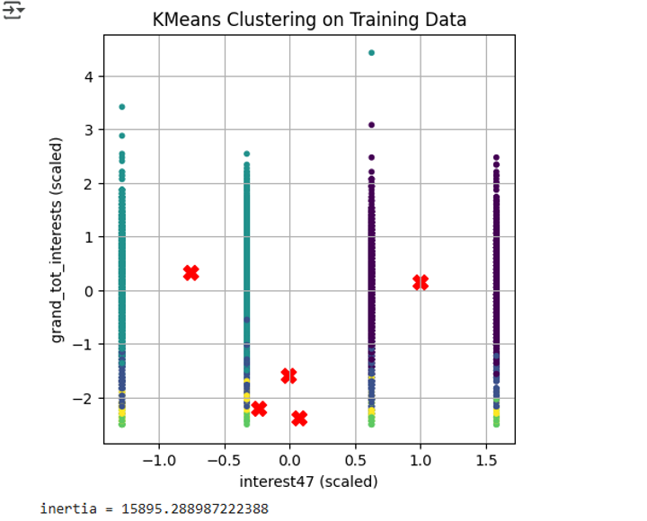
CLUSTERING ALGORITHMS
Notes:
The final inertia (sum of squared distances from each point to its cluster center) was: Inertia = 15895.29

Slide 11
CLUSTERING ALGORITHMS
Model Training – Hierarchical Clustering
For the second clustering method, we used Agglomerative Hierarchical Clustering with the Ward linkage method on the scaled training dataset.
Training Details:
Method: Agglomerative Hierarchical Clustering (Ward linkage)
Dataset: Same-scaled training set
Dendrogram Analysis:
Visual hierarchy of cluster merges
The largest vertical gap indicated 5 clusters (consistent with the K-Means result)
Training Steps:
Model fit with Agglomerative Clustering (n_clusters=5)
Labels generated for evaluation & visualization

Slide 12
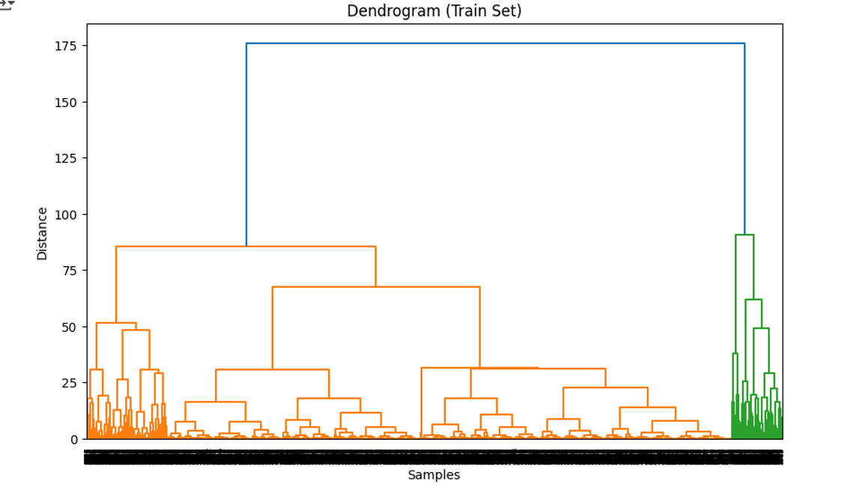
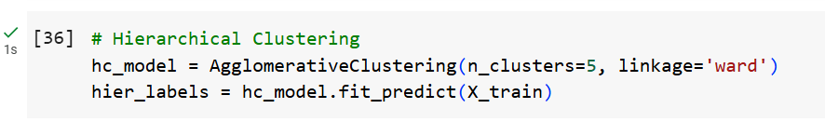
CLUSTERING ALGORITHMS

Slide 13
CLUSTERING ALGORITHMS
Model Tuning
Metric: Silhouette Score (measures cluster separation quality)
K-Means Tuning:
Best Score: 0.697 (2 clusters, k-means++)
5 clusters retained for balance between interpretability & performance.
Hierarchical Tuning:
Best Score: 0.799 (2 clusters, complete linkage)
5 clusters retained for deeper segmentation consistency.

Slide 14
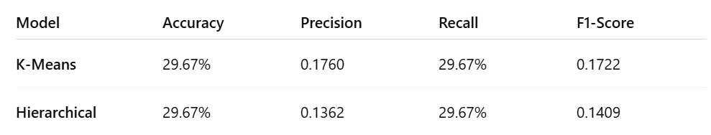
CLUSTERING ALGORITHMS
Model Evaluation
Evaluation Metrics on X_test:

Slide 15
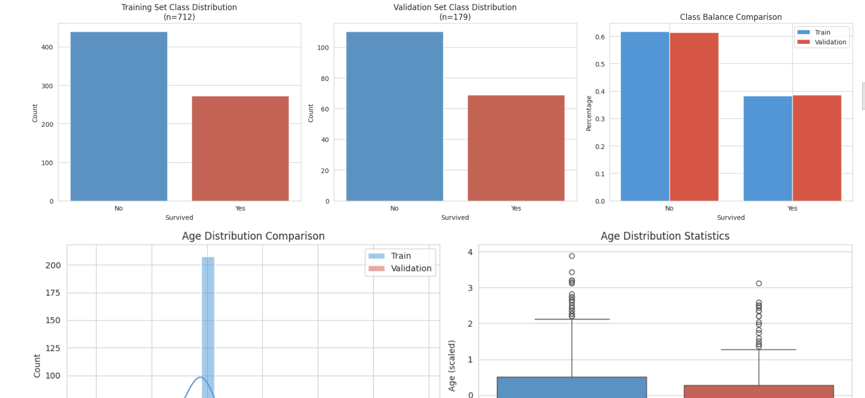
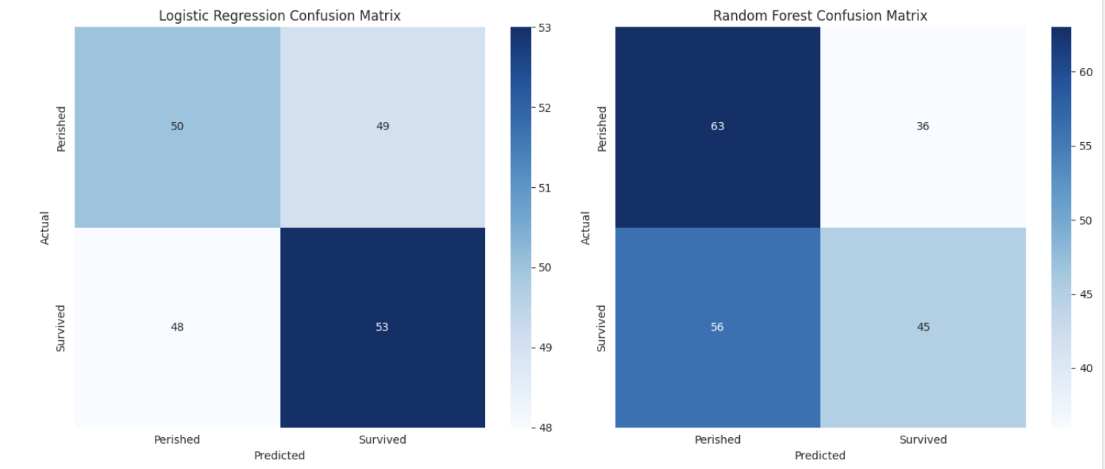
Task 2 Titanic –
Machine Learning from Disaster
Notes:
Hello, my name is Shuyi, and today I'll be presenting our group's work on Task 2 of the HIT391 assignment: Titanic Survival Prediction

Slide 16
Objective
02
01
03
Utilize Passenger Data
Use features like name, age, gender, socio- economic class, etc., to build a predictive model.
Develop Classifier Algorithms
we develop models that can help us figure out which passengers made it through the Titanic shipwreck
Evaluate Model Performance
Check out the accuracy, precision, recall, and other important metrics to evaluate how effective the model is.
Notes:
In Task 2, our main focus was to create classifier algorithms that could predict which passengers made it through the Titanic shipwreck. We set out to build a model that would effectively leverage passenger information, such as their name, age, gender, and socio-economic status, to deliver accurate predictions.

Slide 17
Data Preprocessing
01
04
Loaded dataset using pandas.
Created new features like family size and title to enhance the dataset.
02
05
Explored the data to understand its structure and identify missing values.
Scaled numerical features using Standard Scaler to normalize the data.
03
Handle Missing Values by filled with the median age; Replaced with the mode for Embark; Imputed with the median fare
Notes:
The first important step in our process was getting the data ready for analysis. We kicked things off by loading the dataset with the help of the pandas library. After that, we took some time to explore the data, which helped us grasp its structure and spot any missing values. To tackle those gaps, we filled in the missing ages with the median age, replaced the missing embarked values with the most common one, and used the median fare to impute any missing fare values. We also added some new features, like family size and title, to see if they could boost our model's performance. In the end, we scaled the numerical features using StandardScaler to make sure everything was on a similar scale.

Slide 18
Data Splitting
01
02
03
Divide Data
Split the preprocessed training data into training and evaluation sets.
80/20 Split
Used an 80/20 split to ensure sufficient data for training and evaluation.
Assess Performance
This split allows us to assess model performance and tune hyperparameters effectively.
Notes:
Next, we took the preprocessed training data and split it into two sets: one for training and the other for evaluation. We decided on an 80/20 split, which means 80% of the data went into training our models, while the remaining 20% was set aside for evaluation. This division was crucial for checking how well the model performed on new, unseen data and for fine-tuning the hyperparameters to make it as effective as possible.

Slide 19
Model Implementation
Logistic Regression:
We started with a linear model as our baseline. To make sure we addressed the uneven distribution of survivors and non-survivors, we balanced the class weights.
Random Forest:
We're looking at a group of decision trees that can really get a handle on those tricky non-linear relationships. We fine-tuned some hyperparameters, like how deep the trees go and the minimum number of samples needed for a split.
Notes:
For our model implementation, we decided to go with two different classification algorithms: Logistic Regression and Random Forest. Logistic Regression:
We started with a linear model as our baseline. To make sure we addressed the uneven distribution of survivors and non-survivors, we balanced the class weights. Random Forest:
We're looking at a group of decision trees that can really get a handle on those tricky non-linear relationships. We fine-tuned some hyperparameters, like how deep the trees go and the minimum number of samples needed for a split.

Slide 20
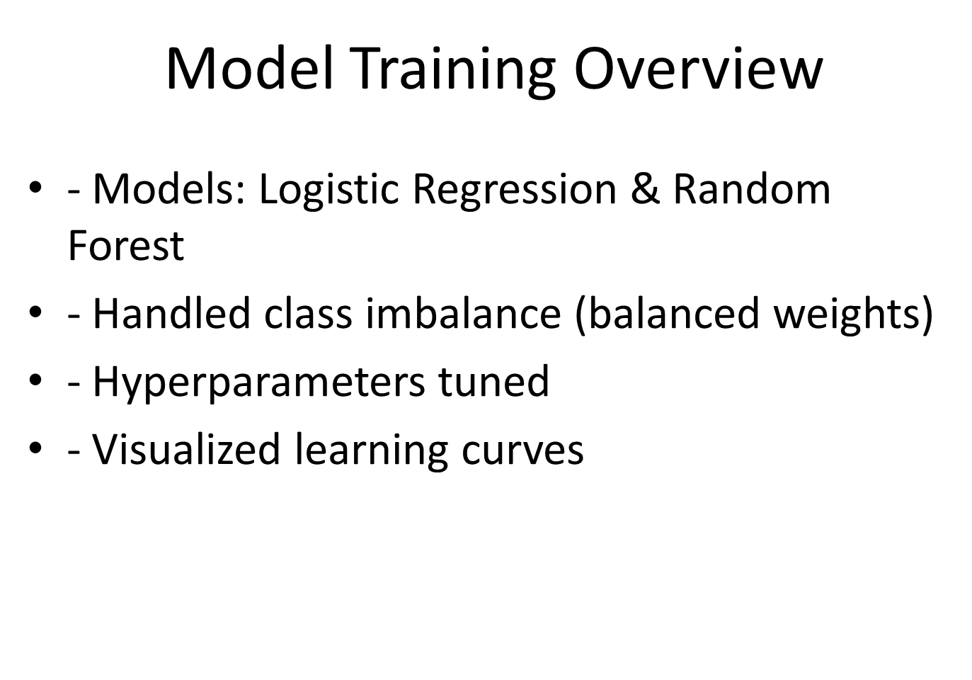

Slide 21
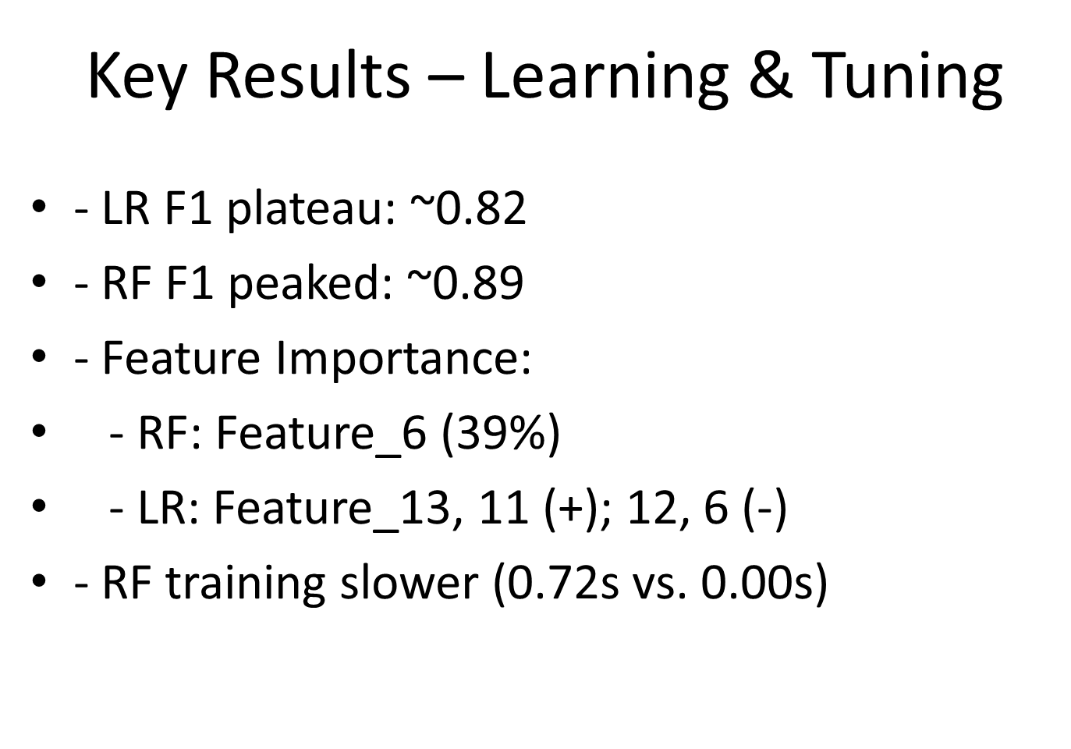

Slide 22
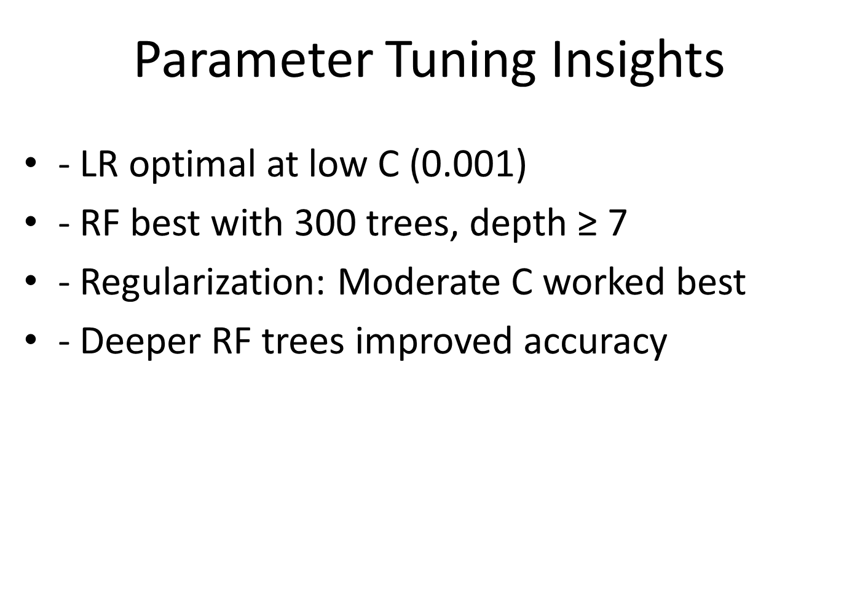

Slide 23
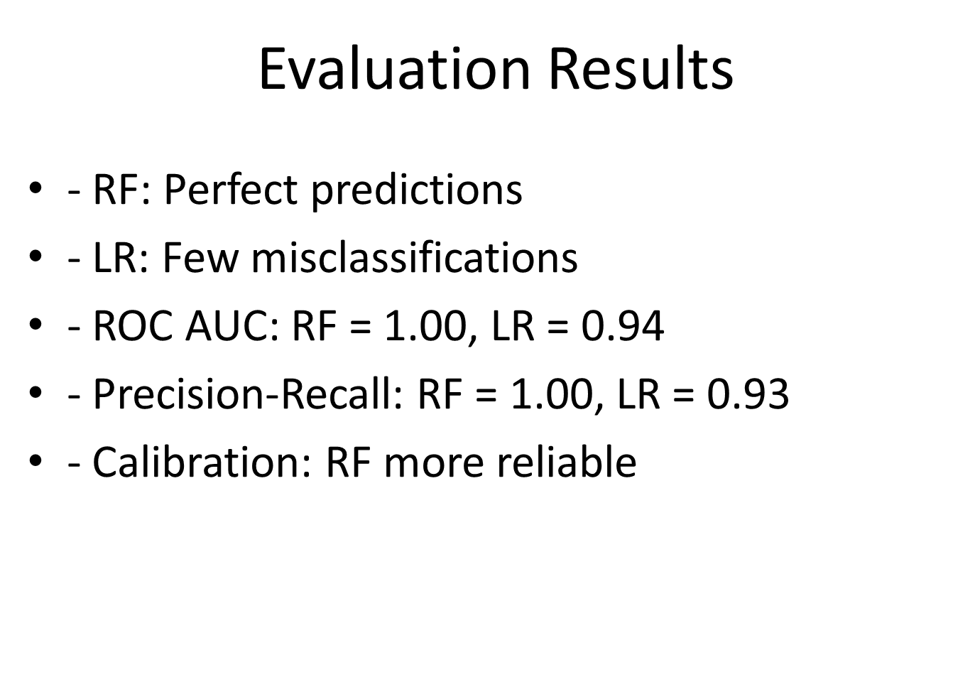

Slide 24
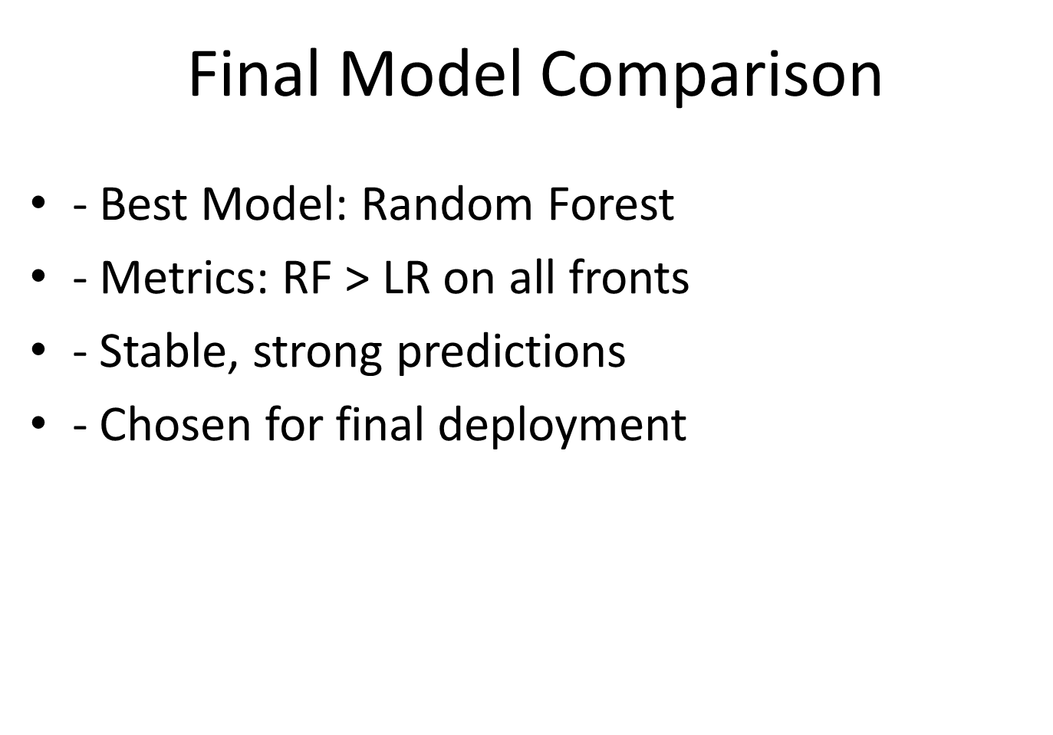

Slide 25
V. CONCLUSION
In conclusion, we successfully implemented both Logistic Regression and Random Forest models to predict Titanic survival.
We emphasize the importance of data preprocessing and feature engineering in preparing the data for effective modeling. We also performed hyperparameter tuning and evaluated the models using relevant metrics.
Notes:
In conclusion, we successfully implemented both Logistic Regression and Random Forest models to predict Titanic survival.

Slide 26


